Slide 1
Org chart templates
Create professional slides faster
thinkcell | 2026

Slide 2
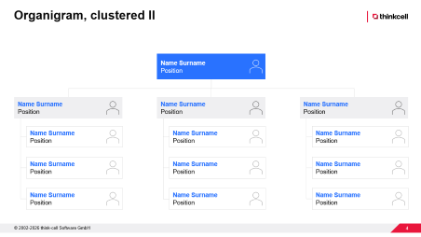
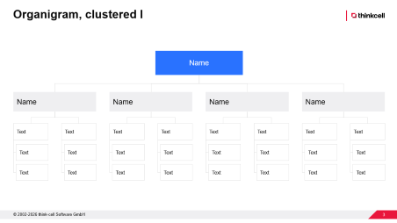
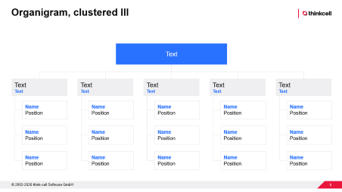
You can use thinkcell to update your org chart template in seconds
Guide to using thinkcell slide templates
How to use and adapt an org chart template
Get started with thinkcell
Start with the most suitable org chart
  Choose from the three provided templates and add the one you need to your presentation.
Apply your corporate identity
  Use your brand colors for texts and elements at different levels, such as headlines, copy, and shape outlines.
Populate the org chart with your information
  Add department and employee names, and adjust the number of branches to match your team structure.
Use thinkcell for faster slide editing
  Get a free thinkcell trial to access tools that help you easily align and resize objects for polished layouts.
Create professional charts and data-driven tables.
Deliver impactful presentations faster.
Try for free, no credit card required and no cancellation necessary.
Start free trial
Start free trial

Slide 3
Organigram, clustered I
  Name
  Name
  Name
  Name
  Name
  Text
  Text
  Text
  Text
  Text
  Text
  Text
  Text
  Text
  Text
  Text
  Text
  Text
  Text
  Text
  Text
  Text
  Text
  Text
  Text
  Text
  Text
  Text
  Text

Slide 4
Organigram, clustered II
  Name Surname
  Position
  Name Surname
  Position
  Name Surname
  Position
  Name Surname
  Position
  Name Surname
  Position
  Name Surname
  Position
  Name Surname
  Position
  Name Surname
  Position
  Name Surname
  Position
  Name Surname
  Position
  Name Surname
  Position
  Name Surname
  Position
  Name Surname
  Position

Slide 5
Organigram, clustered III
  Text
  Text
  Text
  Text
  Text
  Text
  Text
  Text
  Text
  Text
  Text
  Name
  Position
  Name
  Position
  Name
  Position
  Name
  Position
  Name
  Position
  Name
  Position
  Name
  Position
  Name
  Position
  Name
  Position
  Name
  Position
  Name
  Position
  Name
  Position
  Name
  Position
  Name
  Position
  Name
  Position

